Slide 1

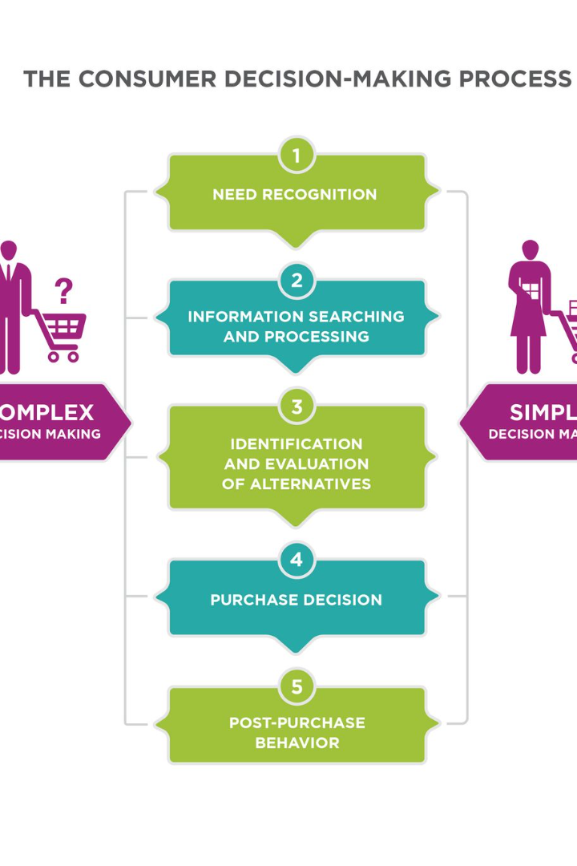
Introduction to Correctness Evaluation
Correctness evaluation is a crucial process in ensuring the accuracy and consistency of brand representation within catalogs. It involves scrutinizing the content of the catalogs to ensure that the visual and textual elements accurately convey the brand's identity and values. This evaluation helps in identifying any discrepancies or errors that may impact the brand's representation and reputation. It plays a key role in maintaining the integrity and trustworthiness of the brand's visual communication.

Slide 2

Importance of Brand Representation in Catalogs
Visual Identity 🎨
Brand representation in catalogs is essential for conveying the visual identity of a brand, including logos, color schemes, and design elements. Consistent visual representation helps in establishing brand recognition and creating a strong visual impact.
Brand Messaging 📜
It allows brands to communicate their unique value proposition and messaging to the target audience. Effective brand representation in catalogs ensures that the brand's story and message are accurately conveyed, leading to better customer understanding and engagement.
Trust and Credibility ✔️
Accurate brand representation builds trust and credibility among customers. When catalogs effectively represent the brand, it enhances the perception of quality and reliability, which is crucial for maintaining a loyal customer base.

Slide 3
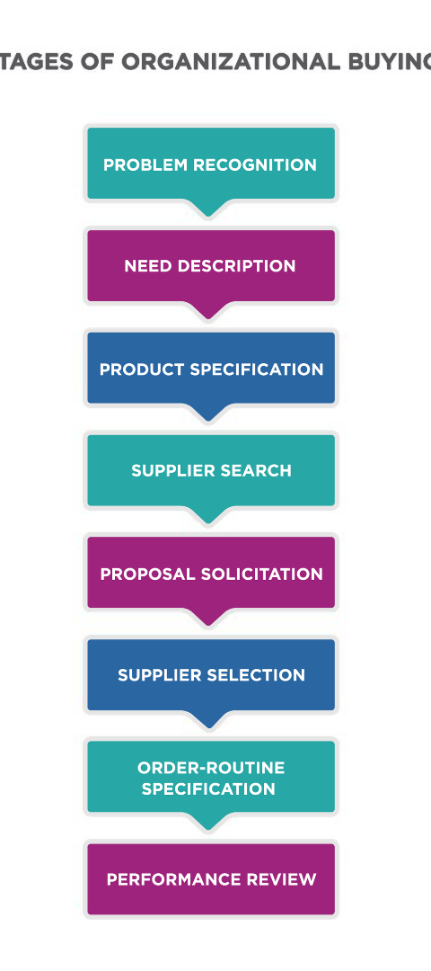
Understanding the Test Case: Scrutiny of Brand Representation
1
Evaluating Visual Elements
Scrutinizing the visual elements such as photographs, graphics, and design layout to ensure they accurately reflect the brand's aesthetic and style.
2
Assessing Textual Content
Examining the textual content for consistency with the brand's messaging, tone, and voice, ensuring that it aligns with the overall brand identity and values.
3
Checking Brand Guidelines Adherence
Verifying that the catalog content complies with the brand guidelines regarding logo usage, color palette, typography, and other visual aspects.

Slide 4
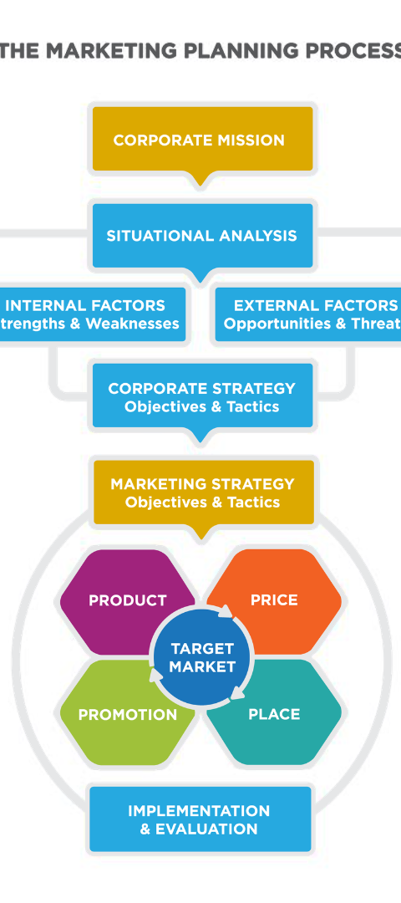
Key Factors to Consider During Scrutiny
1
Consistency
Ensuring that the brand representation remains consistent across different sections and pages within the catalog.
2
Alignment with Brand Values
Evaluating whether the catalog content effectively captures and communicates the core values and ethos of the brand.
3
Aesthetic Harmony
Assessing the overall visual harmony and coherence in the representation of brand elements throughout the catalog.

Slide 5
Methods for Ensuring Accuracy in Conveying Brand Representation
Brand Style Guide
Quality Control Processes
Feedback Mechanisms
Developing and strictly following a comprehensive brand style guide to maintain consistency in brand representation.
Implementing robust quality control processes to meticulously review and approve all catalog content before publication.
Establishing feedback mechanisms to gather insights from stakeholders and customers regarding brand representation in catalogs.

Slide 6

Common Errors to Avoid During the Evaluation Process
Inconsistency
Avoiding inconsistencies in visual and textual elements that can dilute the brand's identity and create confusion.
Overlooking Brand Guidelines
Avoiding the oversight of brand guidelines, which may lead to inaccuracies in color usage, logo placement, and design elements.
Lack of Stakeholder Engagement
Avoiding the lack of involvement of key stakeholders in the evaluation process, which can result in overlooking important brand representation aspects.

Slide 7
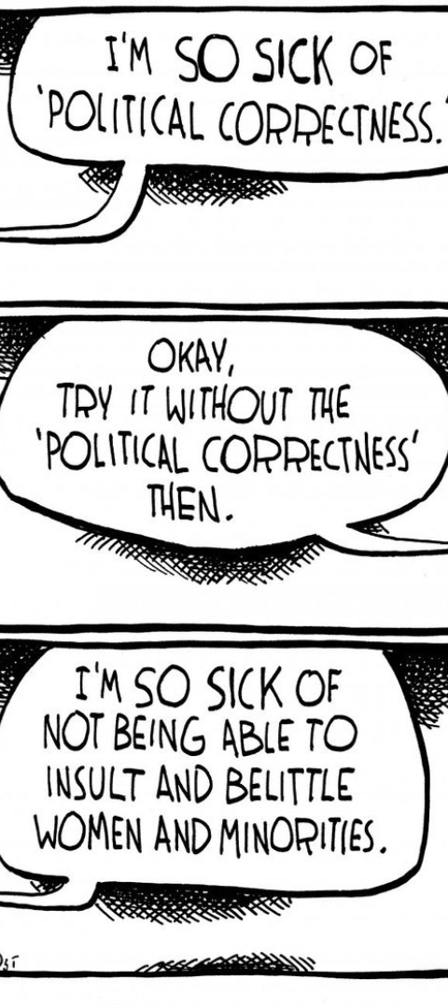



Results and Analysis of the Correctness Evaluation
Data Collection
Collecting and organizing all the scrutinized data related to brand representation within the catalog.
Comparative Analysis
Comparing the catalog content with the established brand guidelines and industry standards to identify any discrepancies.
Insights and Recommendations
Deriving insights from the analysis and formulating actionable recommendations for enhancing brand representation accuracy.

Slide 8
Conclusion and Recommendations for Future Evaluations
5
3
Regular Audits
Employee Training
Conduct regular audits to continually assess and improve brand representation accuracy.
Provide comprehensive training to employees involved in catalog creation to ensure adherence to brand representation standards.

